Slide 1
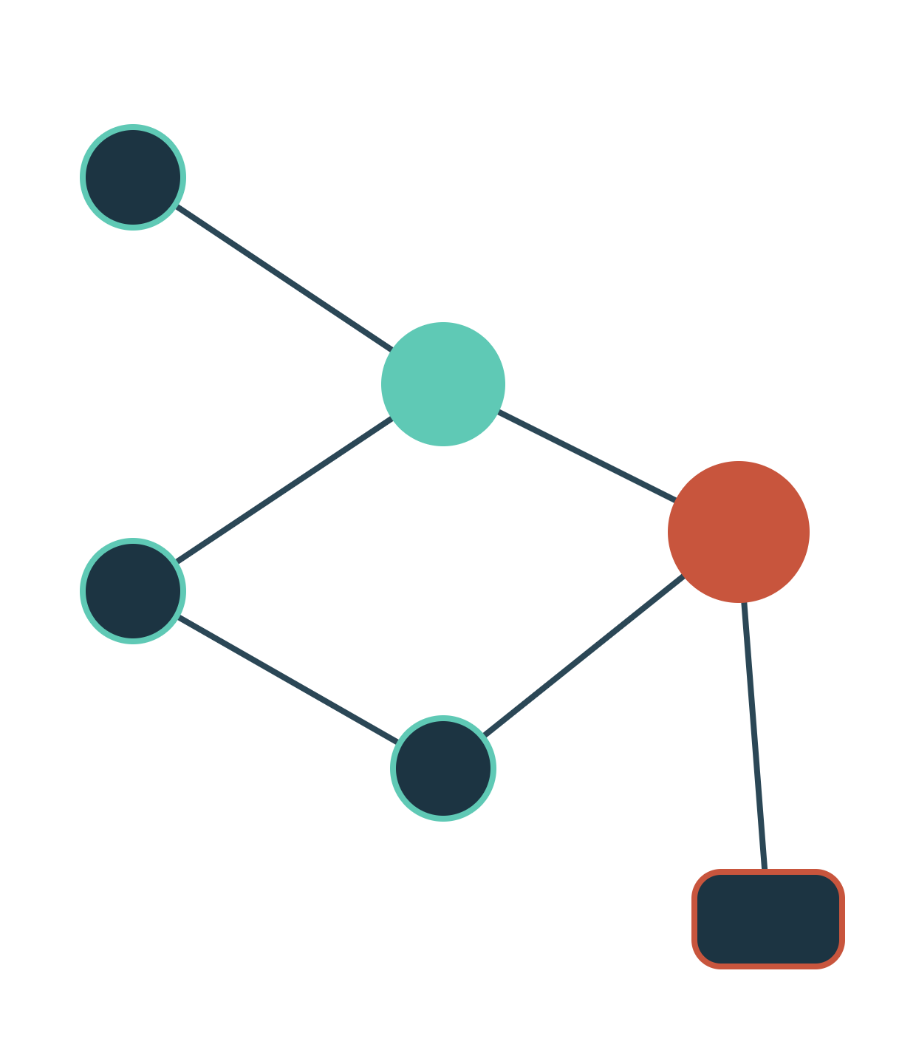
KOITA HACKATHON · USE CASE 04 · CLINIC OPERATIONS & PATIENT FLOW
OncoFlow
Orchestrator
Dependency-driven patient flow for cancer clinics. Patients move when their labs are verified, not when a paper queue says so.
Notes:
Open with the vision: move oncology day care from static queues to lab-triggered orchestration, to protect immunocompromised patients and use every chair-hour.

Slide 2

THE PROBLEM
Every oncology visit is a chain of dependencies
01
02
03
04
05
Blood draw
Lab verified
Consult
Pharmacy prep
Infusion chair
If one link is late, everything downstream stalls: a single delayed report can idle a doctor, a pharmacist and a chair at the same time.
Doctors wait
Chairs sit empty
Patients wait exposed
Consults cannot start without same-day verified labs, so morning slots slide into the afternoon.
Infusion chairs are held for patients still waiting on labs or pharmacy: "ghost slots" that burn capacity.
Immunocompromised patients sit for hours in crowded rooms, while coordinators chase status by phone.
OncoFlow Orchestrator · KOITA Hackathon, Use Case 04 · 02
Notes:
Walk the chain left to right. Stress that these are hard sequential dependencies: chemo cannot start without same-day verified labs. Then the three consequences: idle doctors, empty chairs, exposed patients and burnt-out staff.

Slide 3
THE MATH OF WAITING
Waiting-room crowding follows Little's Law
L = λ·W
Scenario | λ / hr | W on-site | L in room
Physical queue | 20 | 1.5 h | 30
Virtual queue | 20 | 0.25 h | 5
L = average people in the waiting room
λ = arrival rate (patients per hour)
W = average time each one waits on-site
Arrivals λ stay the same. Cutting on-site W by 6× cuts crowding L by 6×. W is the lever, and OncoFlow moves most of it off-site.
Exposure-hours per day:
E = λ · H · W (H = clinic hours)
Notes:
Little's Law holds for any stable queue regardless of arrival distribution, so it is a safe back-of-envelope. The key point: we do not need to see fewer patients to reduce crowding; we reduce the time each spends physically waiting. Exposure-hours E is the sum of on-site waiting times across the day, equal to lambda times H times mean W.

Slide 4



OUR SOLUTION
OncoFlow runs the day on readiness, not arrival order
Lab-triggered queuing
Virtual waiting room
Chemo chair "Tetris"
Listens to the LIS. A patient enters the call-up queue only when every prerequisite report is marked final. No premature call-ups, no idle doctors.
Patients wait in their car or the cafeteria. A WhatsApp alert arrives when their next milestone, a free doctor or a prepped chair, is minutes away.
When a session runs long, a constraint solver reshuffles upcoming patients across chairs in seconds, so no chair sits idle while someone is ready.
OncoFlow Orchestrator · KOITA Hackathon, Use Case 04 · 04
Notes:
Three pillars. Each maps to one failure on the problem slide: lab-triggered queuing fixes idle doctors, the virtual waiting room fixes exposure, chair Tetris fixes ghost slots.

Slide 5
THE PATIENT JOURNEY
Four steps from arrival to infusion chair
01
02
03
04
Check in
Monitor
Trigger
Execute
Blood draw done. The patient scans a QR code, joins the virtual waiting room and picks where they will wait.
OncoFlow subscribes to LIS events (HL7 v2 ORU^R01 or FHIR DiagnosticReport) and tracks each prerequisite.
Report turns final, the dependency clears, the dashboard updates live and the patient gets a WhatsApp "please come in".
After the consult, the scheduler assigns the best-fit chair and notifies pharmacy and the infusion nurse.
Coordinator view: every patient's state on one screen. Drawn → Verified → With doctor → Awaiting chair → Infusing.
OncoFlow Orchestrator · KOITA Hackathon, Use Case 04 · 05
Notes:
Step 3 is the heart of the system: the only trigger is a status change on the report, never its content. The coordinator sees a simple state machine per patient.

Slide 6
DEPENDENCY ENGINE
A patient is called only when every prerequisite is met
P(i): prerequisites of step i (lab panels, a free doctor slot, pharmacy prep done), modelled as a DAG.
status_d is a flag only: HL7 OBR-25 = "F" or FHIR DiagnosticReport.status = final. Values are never parsed.
Q90(TAT_d): 90th-percentile turnaround for that panel from 30 days of status timestamps. Conservative, so nobody is called early.
τ_i: walk time from the patient's chosen wait spot; δ: safety buffer, e.g. 5 min.
// 1. readiness of step i at time t
ready_i(t) = ∀ d ∈ P(i): status_d(t) = FINAL
// 2. predicted ready time
T_i = max over d ∈ P(i) of (t_draw,d + Q90(TAT_d))
// 3. expected start and when to ping
S_i = max(T_i, t_free,doctor)
notify_i iff S_i − t ≤ τ_i + δ
OncoFlow Orchestrator · KOITA Hackathon, Use Case 04 · 06
Notes:
Equation 1 is the hard gate: a boolean AND over prerequisites. Equation 2 is only for proactive alerts, using an empirical quantile of turnaround time, which is a logistics statistic, not a clinical one. Equation 3: we ping the patient early enough that their walk time plus buffer ends right as the doctor becomes free. If a report is still not final when predicted, the gate in equation 1 simply holds; the prediction never overrides the gate.

Slide 7
SCHEDULING ENGINE
Chair allocation is a constraint program, re-solved on every event
d_p: regimen duration from the existing order plus chair turnover. A nurse's "extended stay" flag lengthens it and triggers a re-solve.
e_p: nurse set-up time; at most N set-ups run at once.
w_p: manual priority flag from the care team, never a computed risk score.
moved_p: penalises re-assigning patients already told a chair, so the plan stays stable.
x[p,k] ∈ {0,1}, Σ_k x[p,k] = 1
s_p ≥ r_p (r_p from readiness engine)
I[p,k] = [s_p, s_p + d_p) present iff x[p,k]
NoOverlap({ I[p,k] : all p }) ∀ chair k
Cumulative([s_p, s_p + e_p), 1, N) nurses
s_p, k_p fixed if p is already infusing
// objective
min Σ_p w_p·(s_p − r_p) + β·Σ_p moved_p
Solved with Google OR-Tools CP-SAT (optional intervals). Warm-started from the last plan with a 2-second limit on a rolling horizon.
OncoFlow Orchestrator · KOITA Hackathon, Use Case 04 · 07
Notes:
Each patient gets exactly one chair (x). Their infusion is an optional interval on each chair that exists only if that chair is chosen; NoOverlap per chair means no double-booking. Cumulative limits how many infusions nurses can start in parallel. The objective minimises weighted delay between ready time and start, plus a penalty for moving people who were already told a chair. Events that trigger a re-solve: report final, consult finished, extended stay flag, no-show.

Slide 8

ARCHITECTURE & STACK
Event-driven, built on open standards
INPUTS
OUTPUTS
ONCOFLOW CORE
LIS
Python · FastAPI
Coordinator
HL7 v2 ORU^R01 or FHIR Subscription: report status only
Integration adapter → Redis Streams event bus
Readiness engine: DAG + turnaround quantiles
Scheduler: OR-Tools CP-SAT, rolling horizon
Live queue state in Redis; audit log in Postgres
WebSocket push to every open dashboard
React dashboard, one pane for the whole unit
EHR
Patients
Admin priority flags, scheduled regimen durations
WhatsApp Business API or Twilio alerts
Nurse app
Pharmacy & nurses
"Extended stay" and "chair free" taps
Prep and chair-ready notifications
OncoFlow Orchestrator · KOITA Hackathon, Use Case 04 · 08
Notes:
Every input is an event. The adapter normalises HL7 v2 and FHIR into one internal event: report X for patient Y is final at time t. Redis Streams gives ordered, replayable events; the solver runs on each relevant event; results are pushed over WebSockets. Latency budget from LIS event to WhatsApp is a few seconds, well inside the patient's walk time.

Slide 9
SCOPE COMPLIANCE
Strictly operational: OncoFlow moves people, it never interprets medicine
Operational input we use | What we never do
Lab report status flag (final or not) | Read, store or interpret any result value
Care-team priority flag in the EHR | Compute risk scores or triage patients
Scheduled duration from the existing order | Change orders, doses or regimens
Nurse's "extended stay" flag | Detect or infer adverse reactions
Every automated action is logistical (a message, a queue position or a chair) and the coordinator can override any of them in one click.
OncoFlow Orchestrator · KOITA Hackathon, Use Case 04 · 09
Notes:
This slide answers the judges' guardrail question directly: zero clinical AI, status-only triggers, no autonomous prioritisation. Everything is a binary operational flag set by a system or a human.

Slide 10
IMPACT & MEASUREMENT
We will prove it with three numbers
Patient safety
Chair capacity
Ghost slots
W = mean(t_call − t_arrive)
U = Σ_p d_p / (C · H)
G = Σ idle_k · 1[q > 0]
Minutes spent physically in the waiting area. Through L = λW it sets crowding and exposure for neutropenic patients.
Share of available chair-hours actually used for infusion across C chairs over H clinic hours.
Chair-minutes left idle while q, the count of ready patients waiting elsewhere, was above zero. Should trend to zero.
Target: [__]% → [__]%
Target: −[__]% vs baseline
Target: near 0 min / day
Staff efficiency: coordinator phone calls and department runs per day, before vs after. Target: −[__]%.
OncoFlow Orchestrator · KOITA Hackathon, Use Case 04 · 10
Notes:
All three metrics come straight from event timestamps we already log, so they can be measured from day one of a pilot. Fill targets once we have the clinic's baseline; do not quote numbers we have not measured.

Slide 11
DEMO & NEXT STEPS
What we will show, and where it goes next
Live demo
Roadmap
A mock LIS streams FHIR report events for a synthetic 40-patient clinic day
Coordinator dashboard and WhatsApp alerts on a real phone
Inject an "extended stay" and watch CP-SAT re-plan chairs in under 2 s
FIFO queue vs OncoFlow, side by side, on the same day
Pharmacy dispensing queue as a new dependency node
Pilot in one day-care unit: 4 weeks baseline, 4 weeks live
Integrations with common LIS / HIS vendors via FHIR
Solving operational bottlenecks in cancer care is an act of patient safety.
[Team name] · [contact email] · Thank you
Notes:
End on the demo plan so judges know exactly what is real today, then the roadmap, then the one-line takeaway.

